Slide 1
Energy profiles by mass (pressure) & deep moist convection
Brian Mapes ATM651
Fall 2023

Slide 2
Convection: why air bothers to move
Thermal energy makes air less dense
Sun heats surface, which puts energy (latent & sensible) in near-sfc air
Meanwhile, upper air cools by infrared radiation
This destabilization makes the atmosphere convect (dry and cloudy)

Slide 3
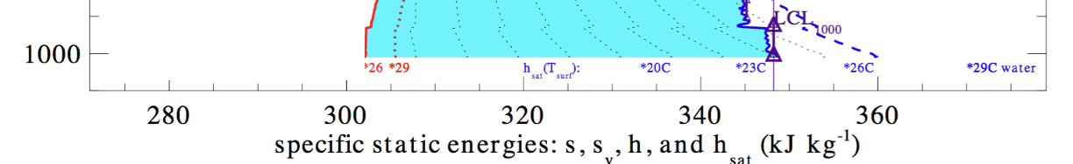
Convection: why air bothers to move
subcloud PBL (below LCL): convection mixes s (s=C_{p}T+gz= const)
ds/dz=0 → dT/dz = -g/C_{p} , the dry adiabatic lapse rate
q and thus Lq and thus h = s+Lq are also well-mixed, constant
lower molecular weight of H2O (virtual effect): s_{v} is also well mixed
pressure (hPa) →

Slide 4
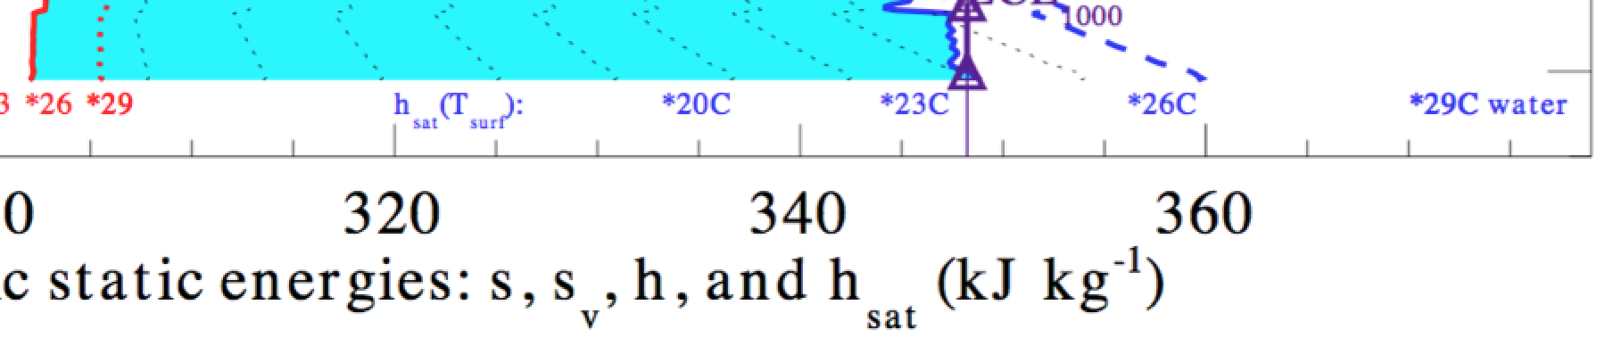
Sensible vs. latent fluxes over tropical ocean
Flux = (vertical turbulent mass flux) * (excess energy per unit mass)
C_{drag} ρ|V| * (s_{sfc}-s_{skin}) or (h_{sfc}-h_{skin})
skin values:
sensible
α this length
latent+sensible
α this length

Slide 5
static energy and parcel buoyancy
s = C_{p}T + gz
Conserved during adiabatic vertical motions (like θ)
dry adiabatic lapse rate in well-mixed layer
ds/dz=0 → dT/dz = -g/C_{p} = Γ_{d}

Slide 6
Static energies II: moist
Dry: s = C_{p}T + gz
Moist: h = C_{p}T+ gz +Lq_{v}
Conserved during adiabatic vertical motions, even if there is condensation (just like θ_{e})

Slide 7
Static energies III: saturated
Dry: s = C_{p}T + gz
Moist: h = C_{p}T + gz + Lq_{v}
Sat: h_{sat} = C_{p}T + gz + Lq_{sat}(T,p)
f (T,p) only: no moisture information
Not conserved at all
Enhanced T(p) info: q_{sat}(T) an increasing function

Slide 8
Static energies: moist, via RH
Dry: s = C_{p}T + gz
Moist: h = C_{p}T + gz + Lq_{sat}(T,p).RH
Sat: h_{sat} = C_{p}T + gz + Lq_{sat}(T,p)
emphasizes that RH sensor only affects h

Slide 9
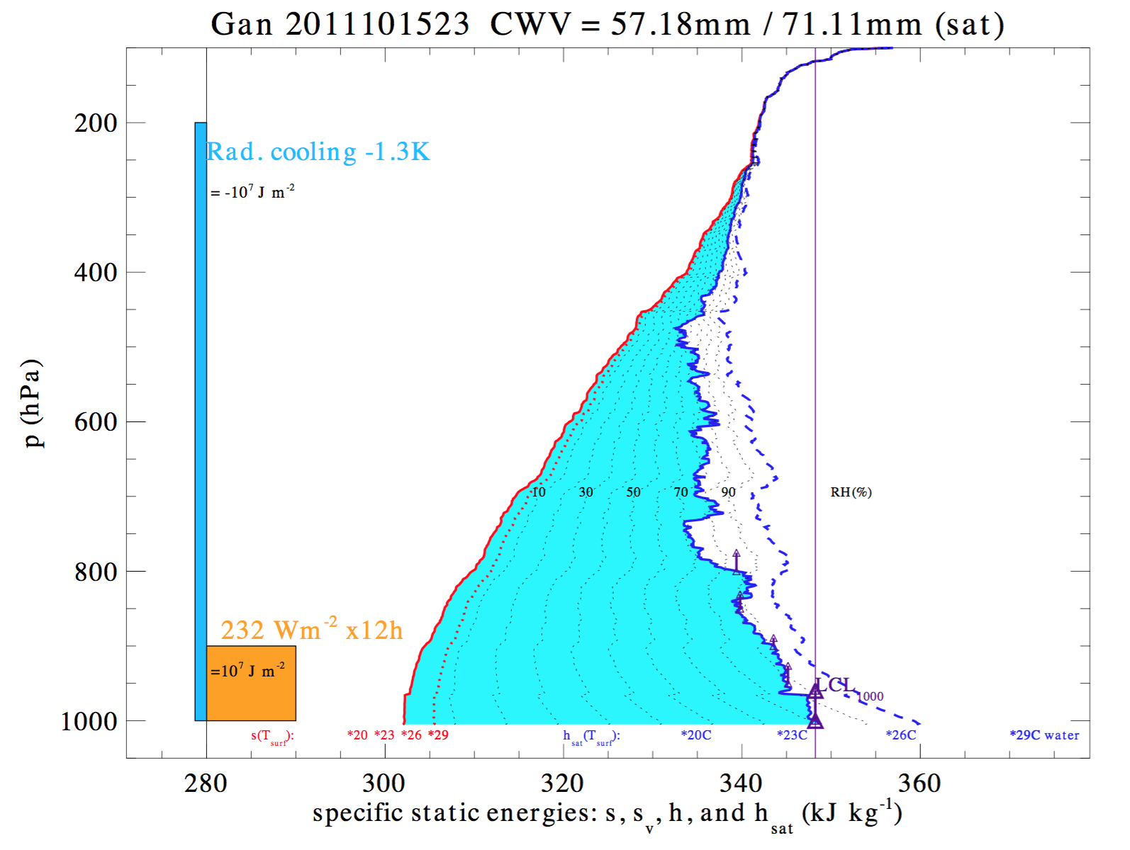
Three profiles tell the story: we saw the bottom 50 hPa already
h_{sat} = C_{p}T + gz_{h}(p)
+ Lq_{sat}(T,p)
s =C_{p}T + gz_{h}(p)
h = C_{p}T + gz_{h}(p)
+ Lq_{sat}(T,p)*RH

Slide 10
Column water vapor (CWV) or Precipitable Water (PW)
α this cyan area
s =C_{p}T + gz_{h}(p)
h = s + Lq_{v}

Slide 11
radiation
Tropical daily
energy increments, roughly
sfc. flux

Slide 12
s for a Minnesota
winter day
h for a
Minnesota
winter day

Slide 13
s for a Minnesota
winter day
a month of
1K/d cooling
h for a
Minnesota
winter day

Slide 14
radiation
Convection
links
sfc energy input to column cooling
sfc. flux

Slide 15
Below the LCL, buoyancy is just s or s_{v}
Surface heating increases s and s_{v}
buoyant parcel rises, mixes with ambient air
→ mixed layer at new, warmer s_{v} (q is well mixed too)
(as radiation cools the clear air by about 1-2 K/d)
equilibrium over warm tropical oceans shown here
pressure (hPa) →

Slide 16
Above the LCL, buoyancy ∼ h_{parcel} – h_{sat-env}
Undilute
parcel
conserves
h

Slide 17
Above the LCL, buoyancy ∼ h_{parcel} – h_{sat-env}
h_{sat,env} =
C_{p}T_{env} + gz + Lq_{sat}(T_{env})
h_{parcel} =
C_{p}T_{par} + gz + Lq_{sat}(T_{par})
T_{par} > T_{env}
since q_{sat}
increases w/T

Slide 18
Mixing
draws
parcel
toward env.
h curve
(proportionally to this distance, for a given mixing or exchange rate)

Slide 19
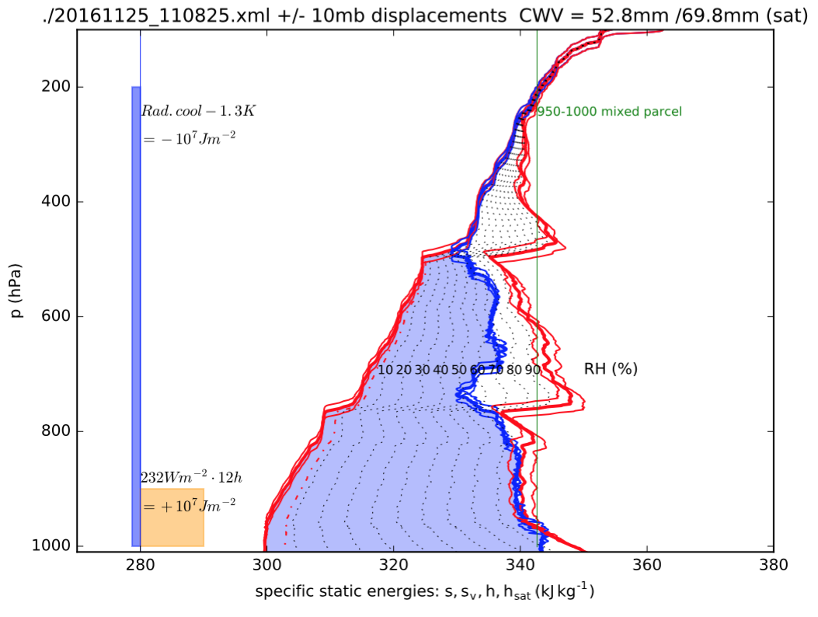
One way to look at a (tropical) sounding: a sample of a “sky” with a statistical population of convective moisture transports from below
DRY RH
DRY RH
hsat inversion
random gravity waves of ~ 10mb vertical displacement magnitude
MEDIUM RH
MEDIUM RH
hsat inversion
HIGH RH
HIGH RH

Slide 20
One way to look at a (tropical) sounding: a sample of a “sky” with a statistical population of convective moisture transports from below
parcel energy if
latent heat of freezing
kicks in
DRY RH
DRY RH
random gravity waves of ~ 10mb vertical displacement magnitude
MEDIUM RH
MEDIUM RH
HIGH RH
HIGH RH

Slide 21
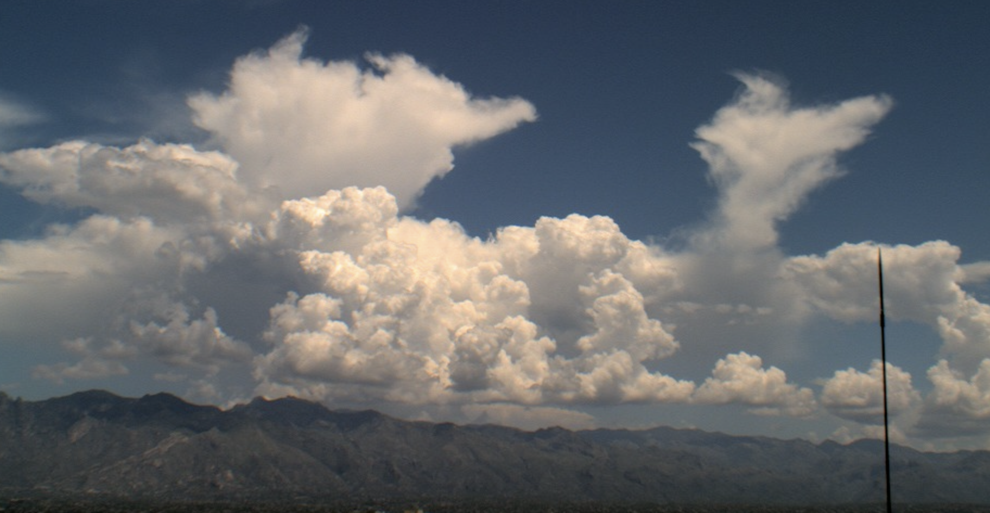
One way to look at a (tropical) sounding: a sample of a “sky” with a statistical population of convective moisture transports from below
parcel energy if
latent heat of freezing
can kick in
DRY RH
DRY RH
random gravity waves of ~ 10mb vertical displacement magnitude
MEDIUM RH
MEDIUM RH
HIGH RH
HIGH RH

Slide 22
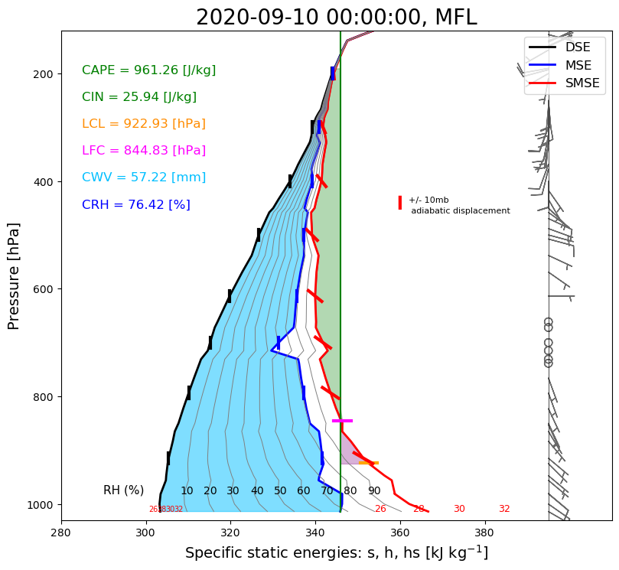
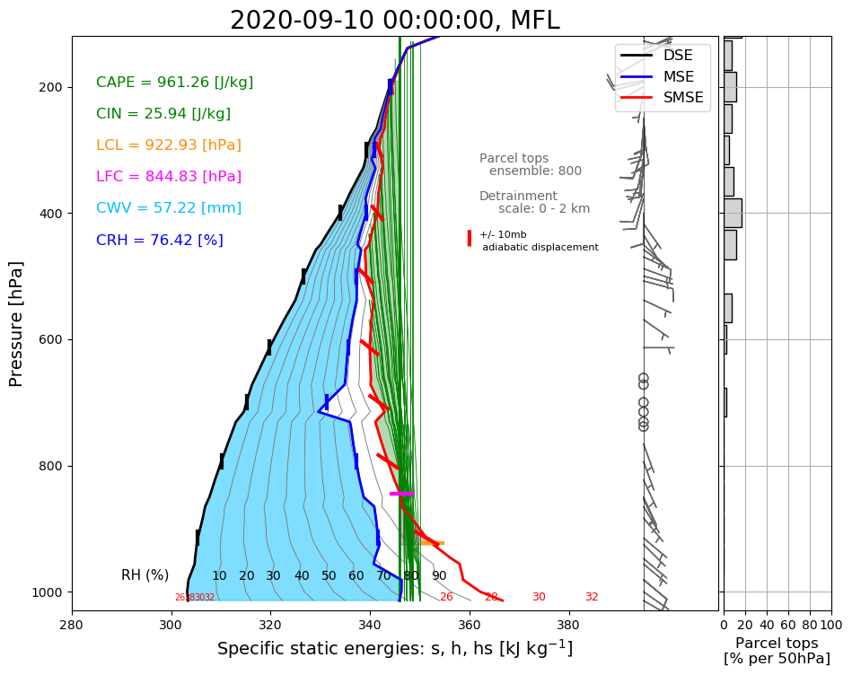
From Colab notebook for class exercise: ensemble of parcels, mixing rates -> detrainment

Slide 23
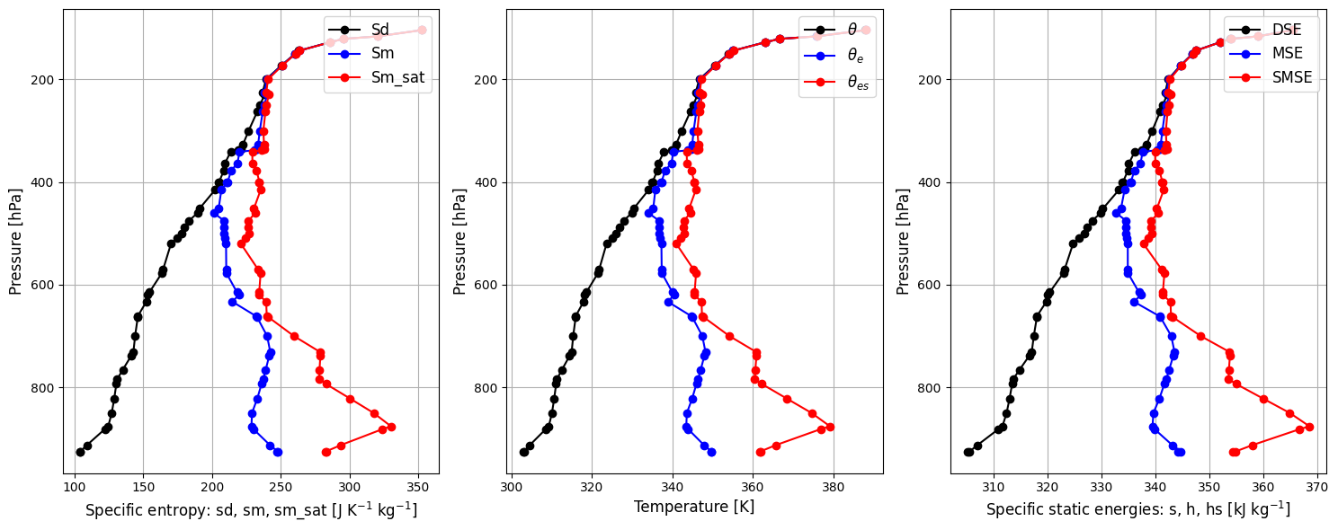
Same geometric relations for entropy, θ−θ_{e} or s-h (but not at all obvious for maths of S,θ)

Slide 24
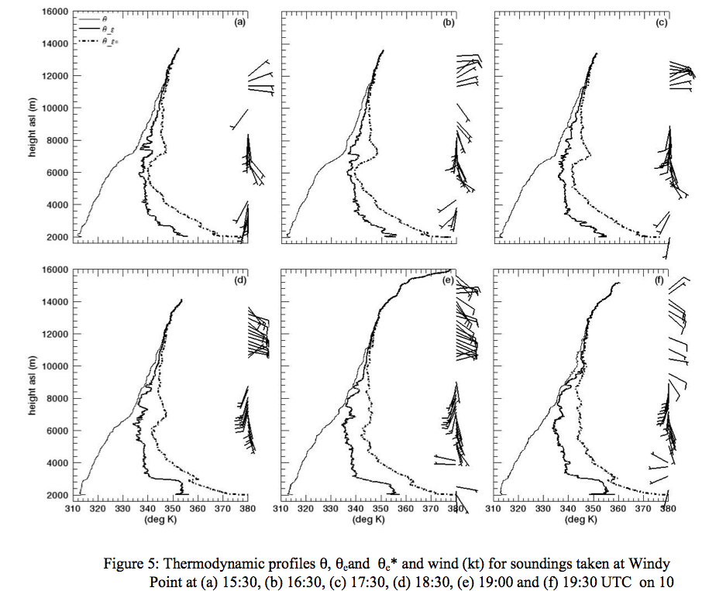
Horrible choice: θ variables vs z, but same story
Zehnder, J.A., J. Hu and A. Razdan, 2009: Evolution of the vertical thermodynamic profile during the transition from shallow to deep convection during CuPIDO 2006. Mon. Wea. Rev., 137, 937-953.
Notes:
Paper by Zehnder et al.Zehnder, J.A., J. Hu and A. Razdan, 2009: Evolution of the vertical thermodynamic profile during the transition from shallow to deep convection during CuPIDO 2006. Mon. Wea. Rev., 137, 937-953.

Slide 25

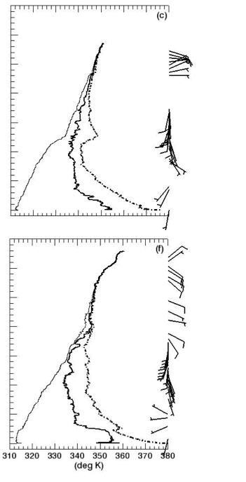
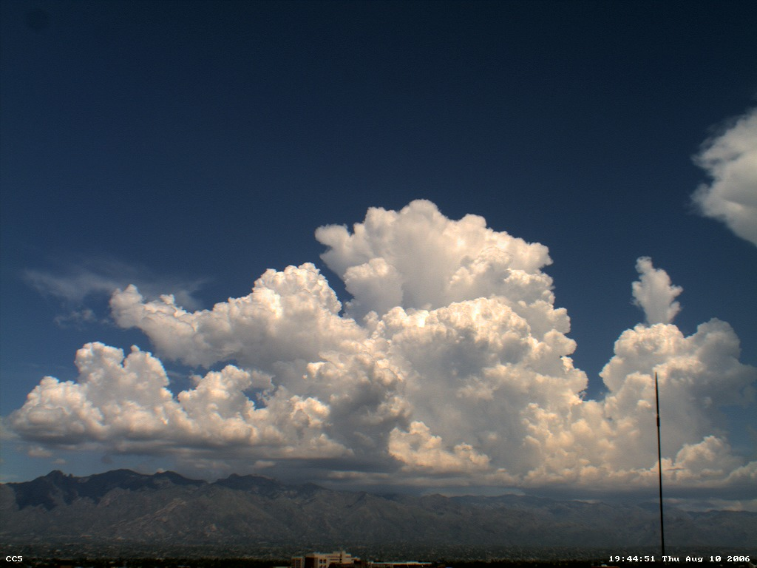

10:30 - 12:30 local change uncaps convection

Slide 26
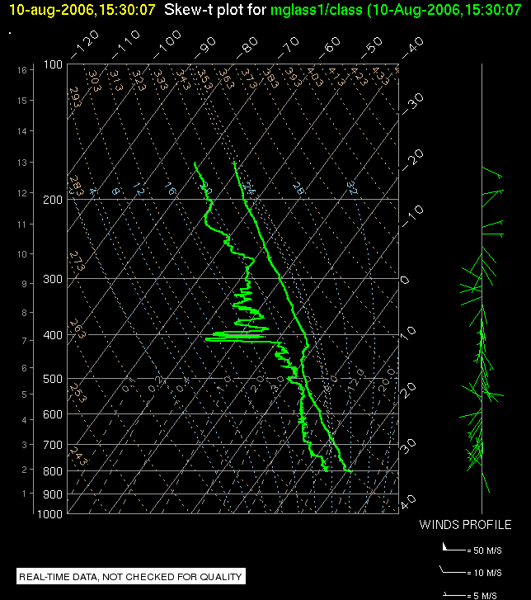
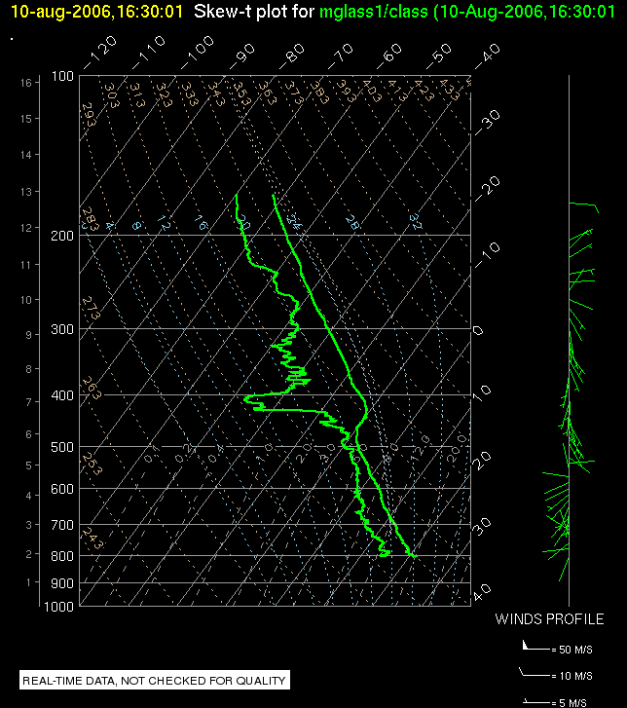
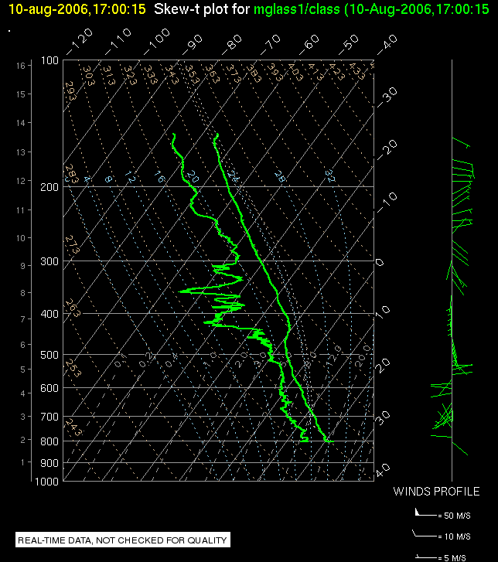
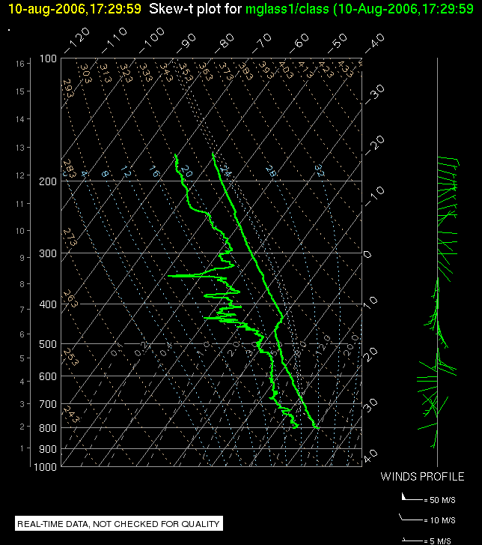
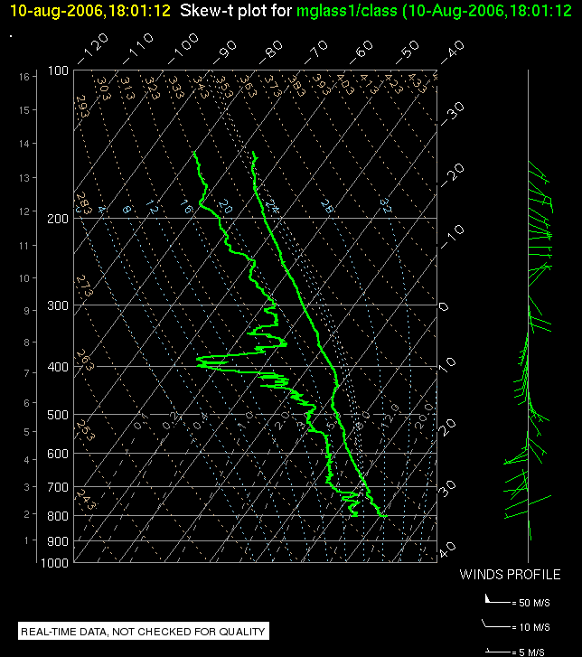

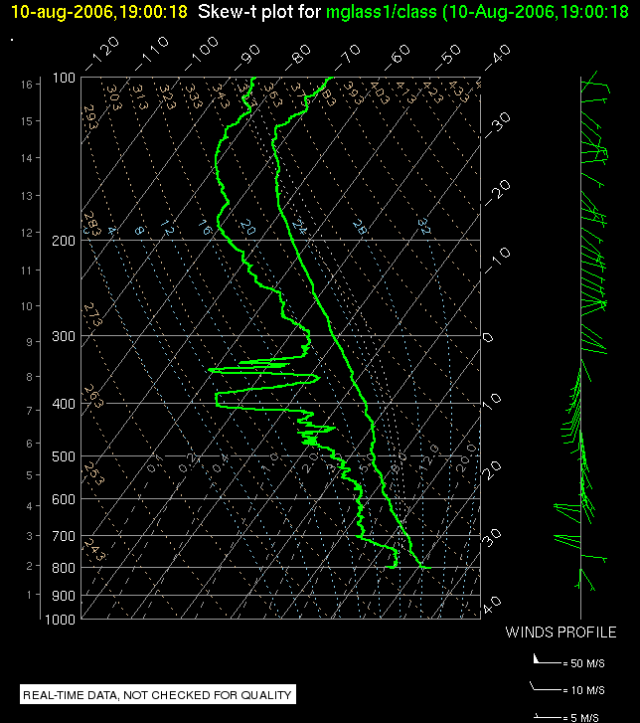
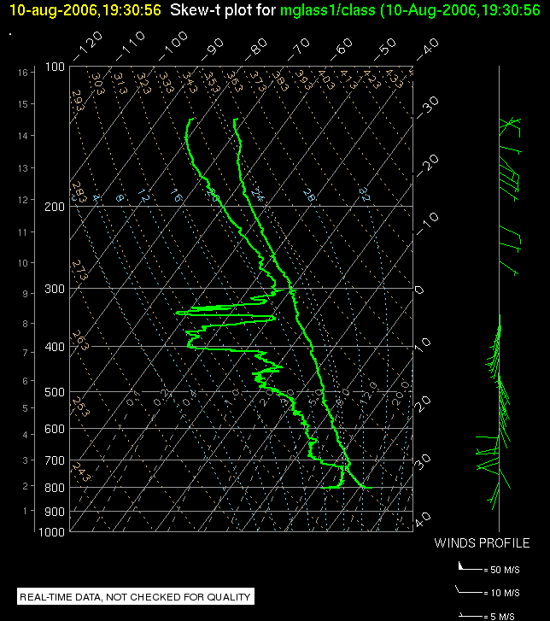
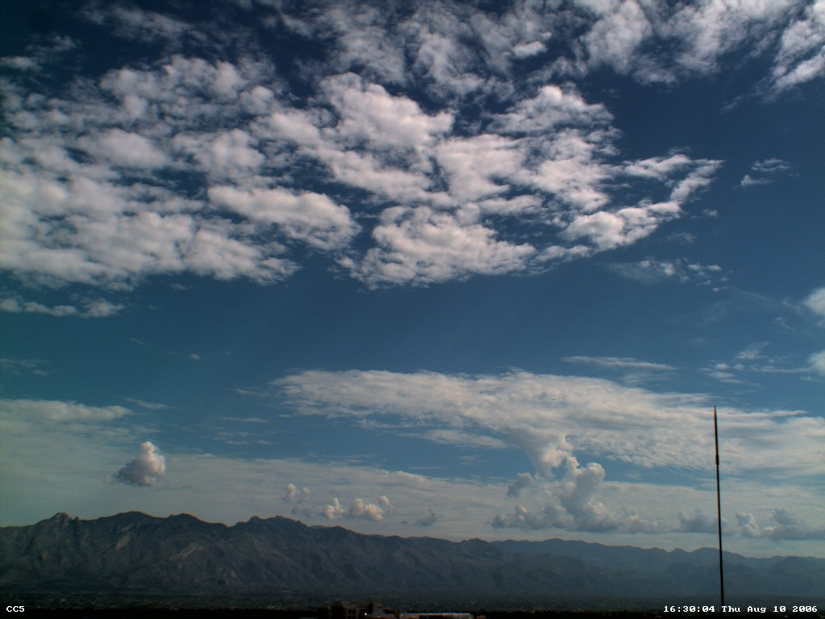
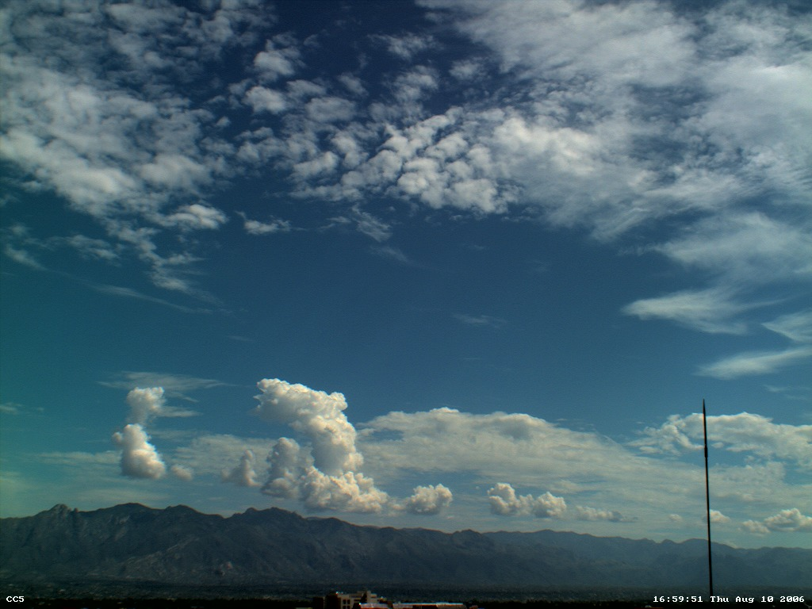
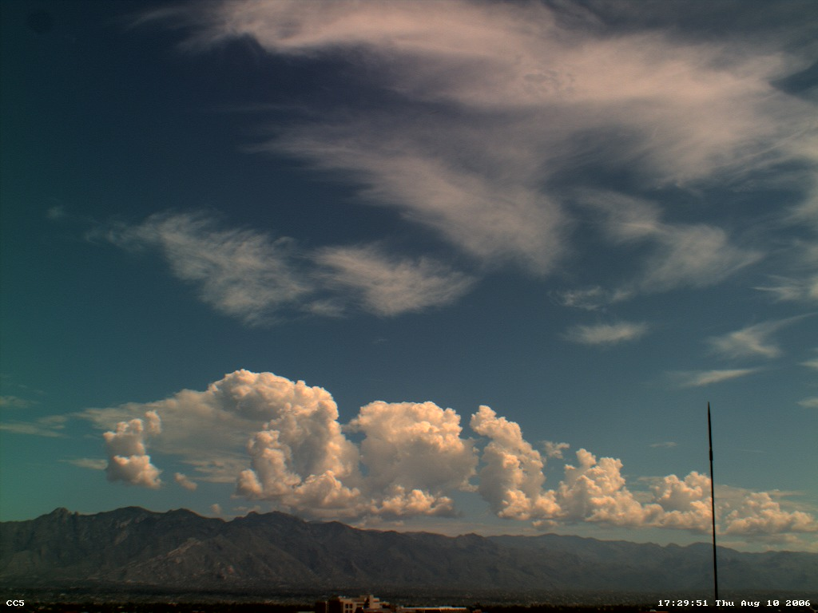
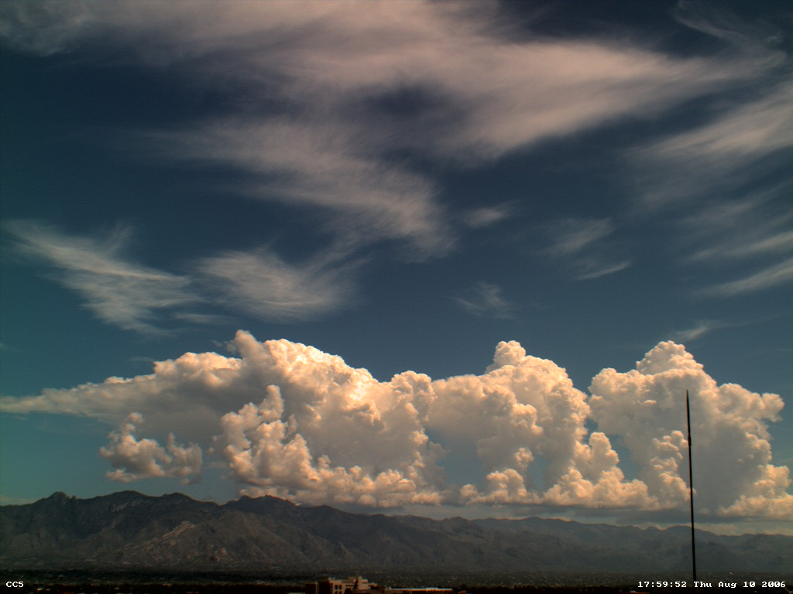
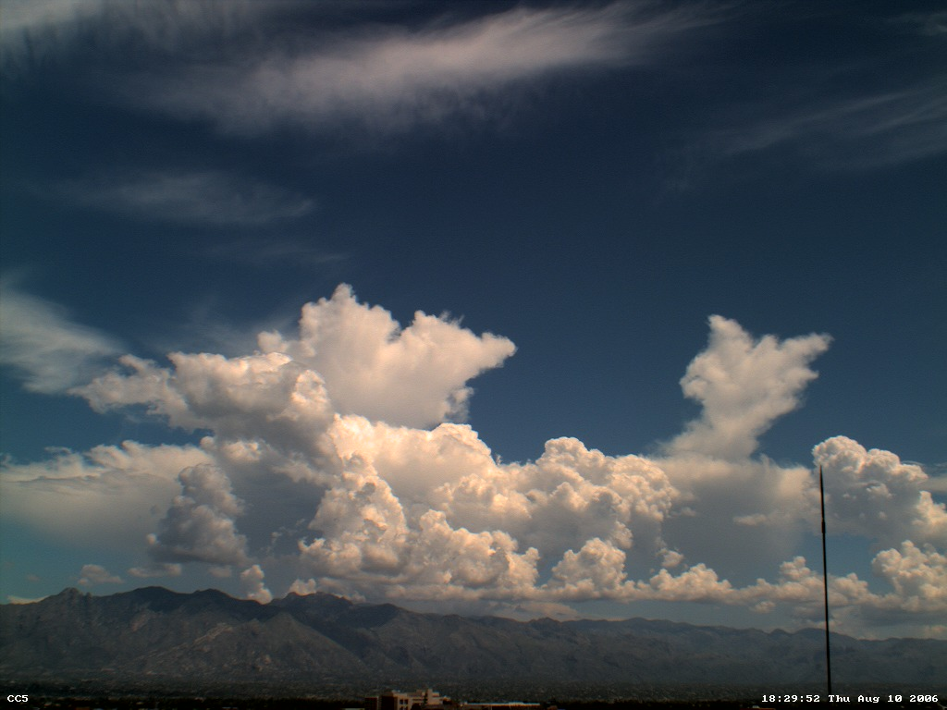
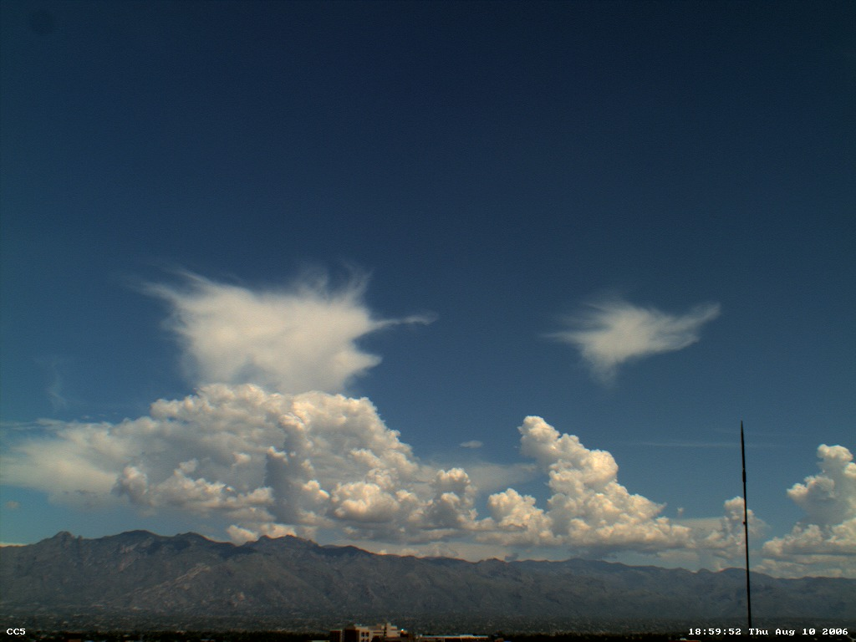
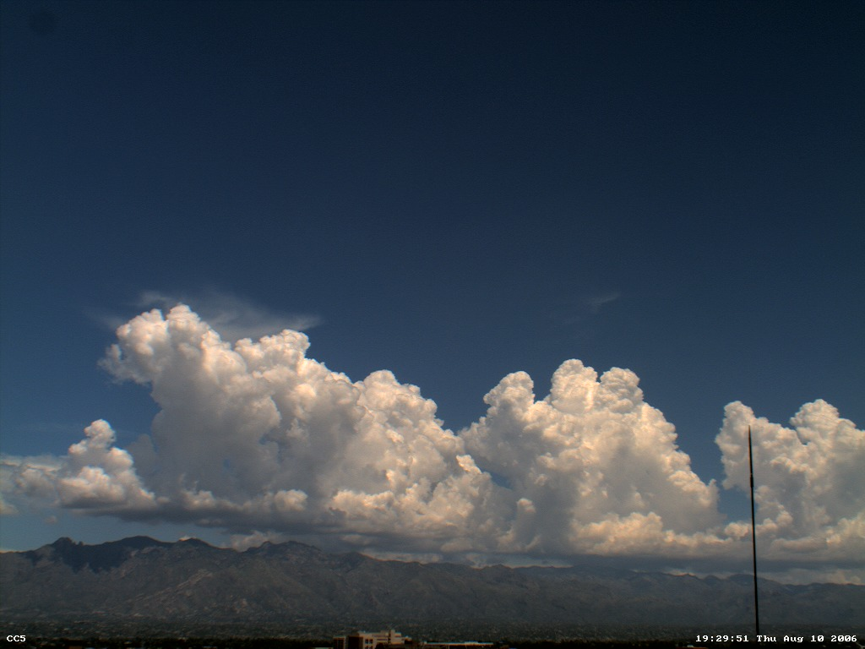
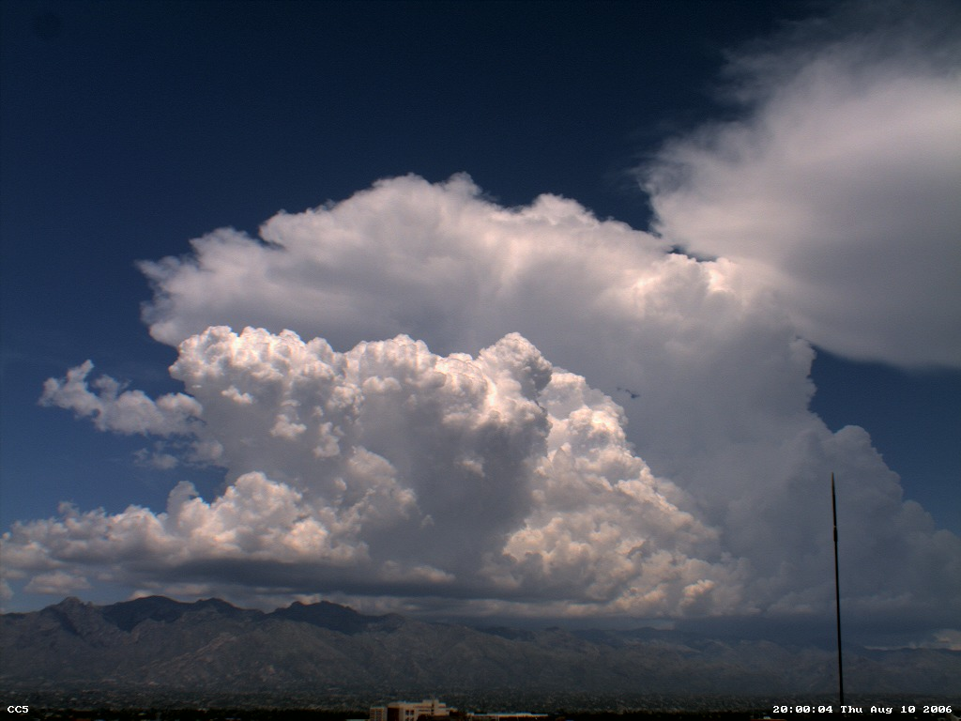
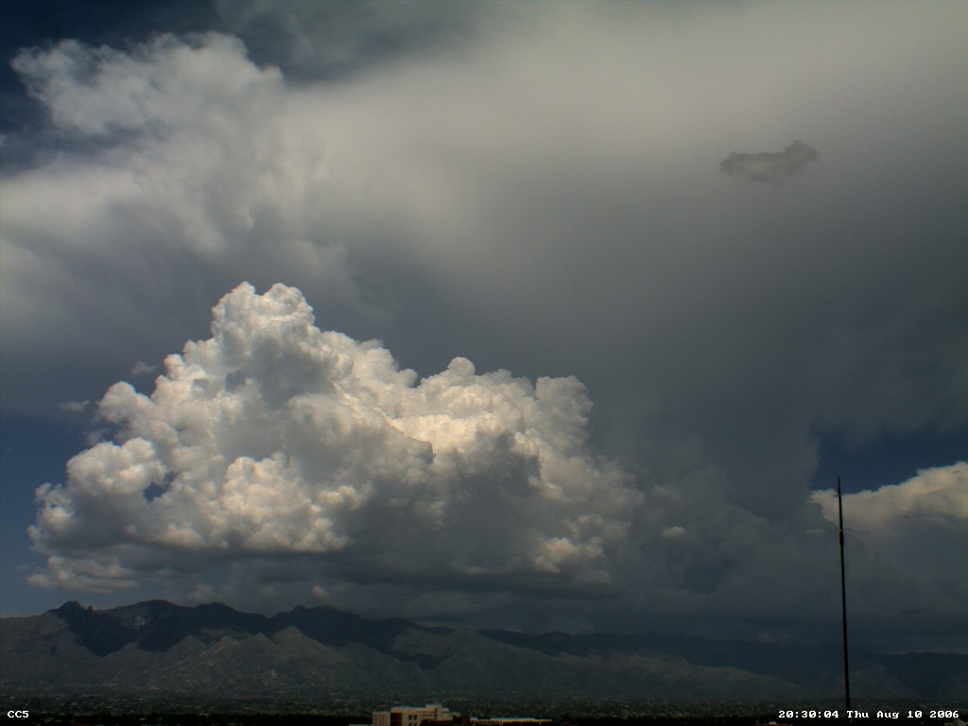
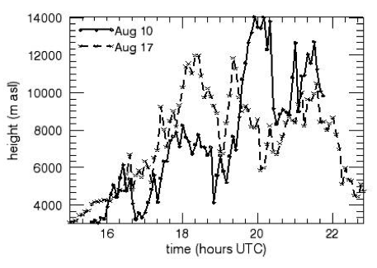
skew-T view of sounding evolution
1530 UTC = 8:30 am, then
9:30,10,1030,11,1130,12,1230 local = 1930 UTC

Slide 27
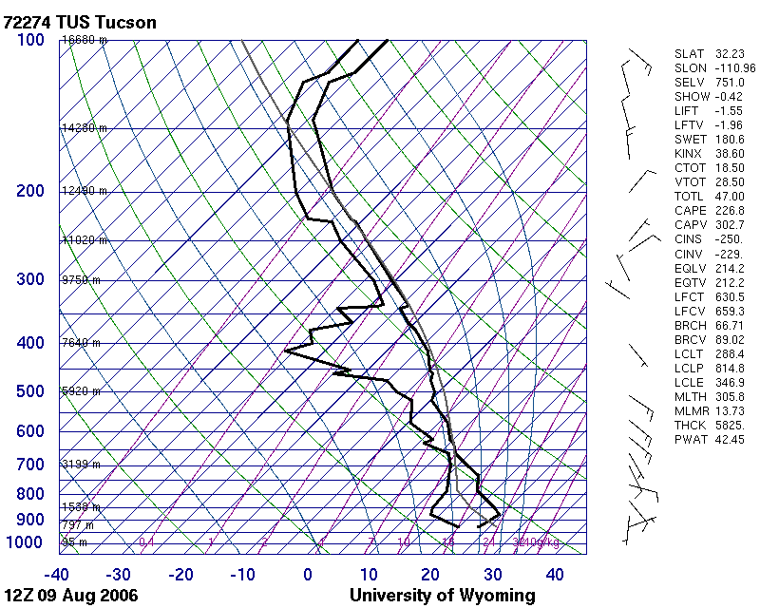
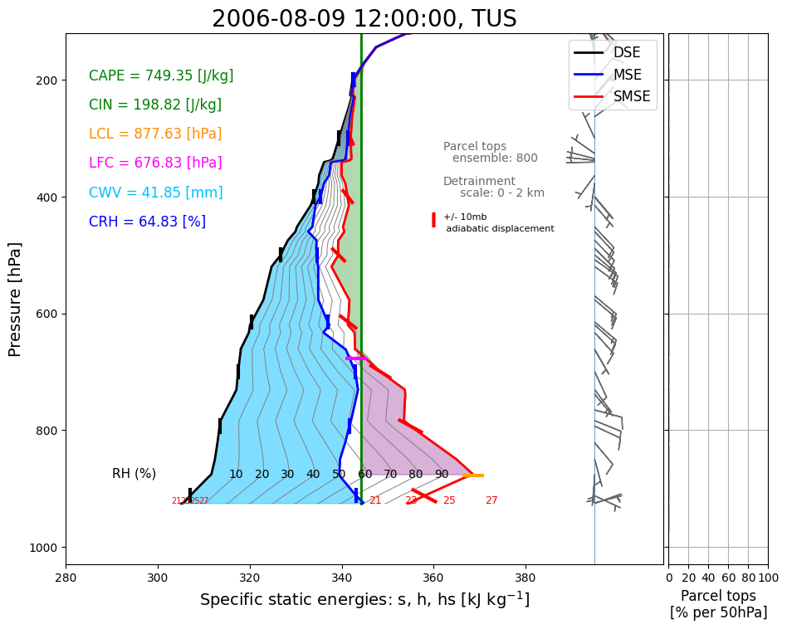

Slide 28
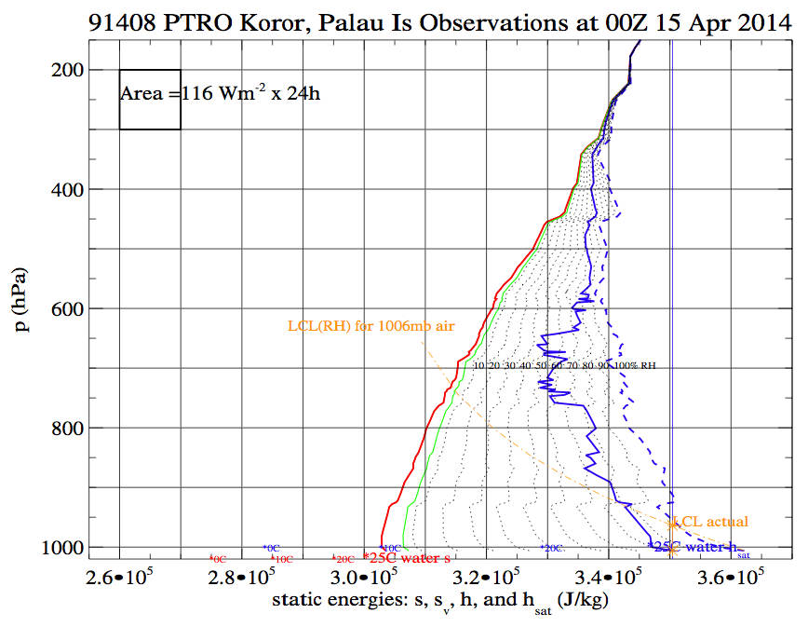
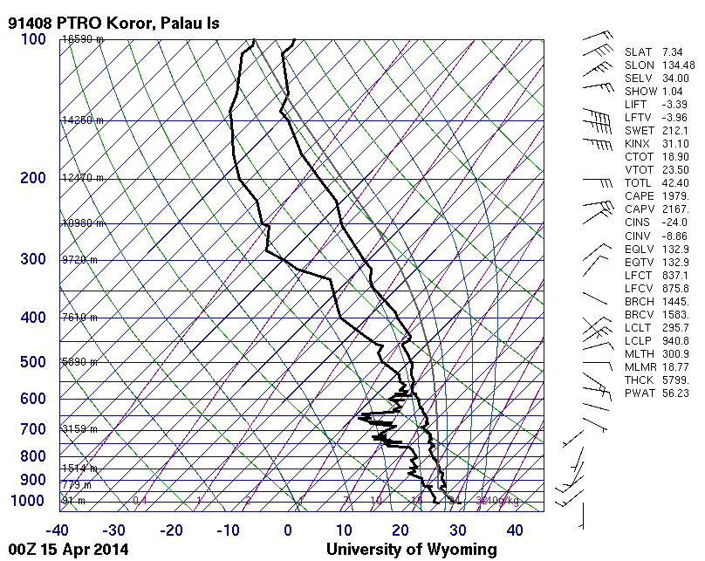
which diagram uses "paper" area
more informatively?

Slide 29
Exercise: get sounding near a multi-depth convective sky photo
https://colab.research.google.com/drive/1CegU2KiBCJn8BNA0urT-M99Nwz7r8Jn-?usp=sharing

Slide 30
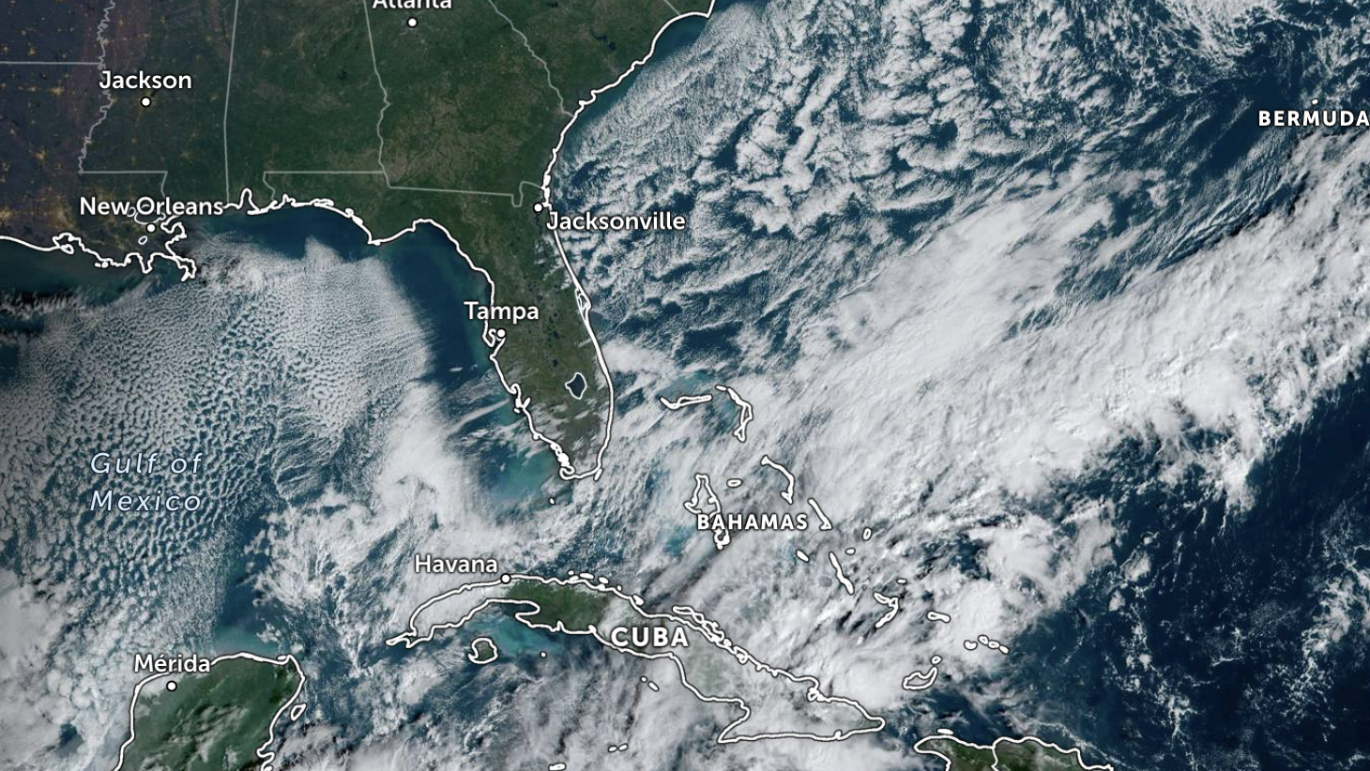
2023-11-02 12Z (today)
Windy from the east, overcast, sprinkles

Slide 31
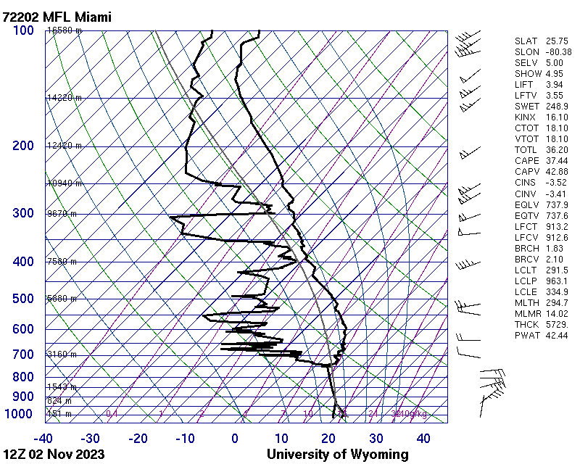
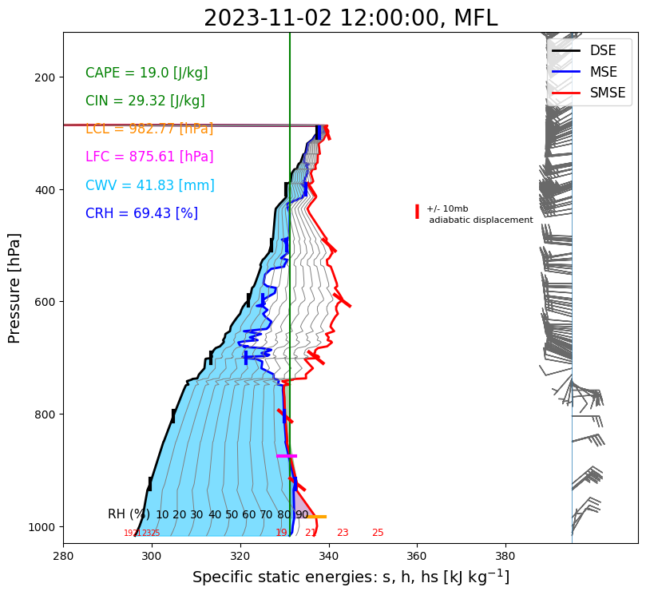
https://weather.uwyo.edu/upperair/images/2023110212.72202.skewt.parc.gif

Slide 32
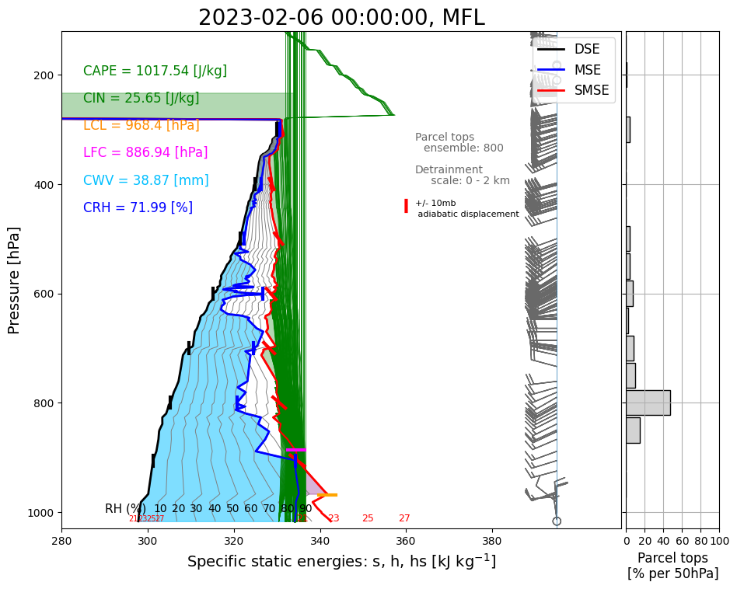



Slide 33

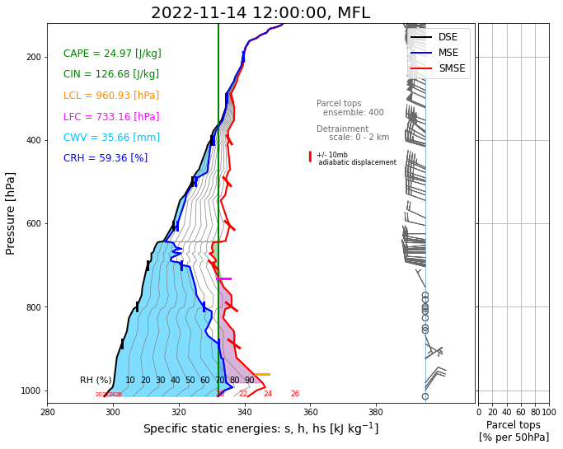

Slide 34
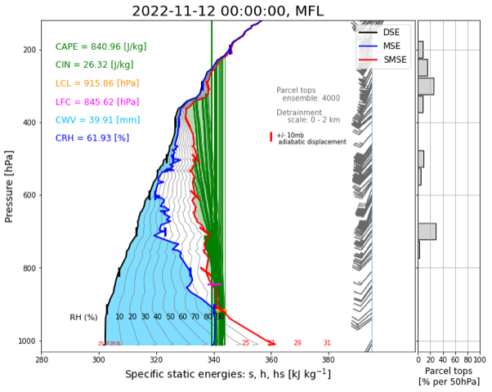


Slide 35
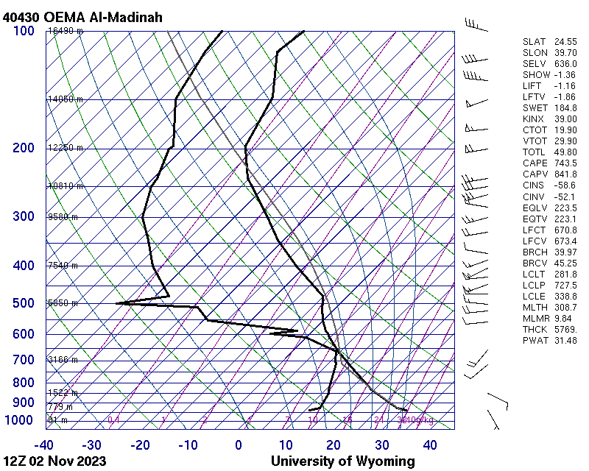
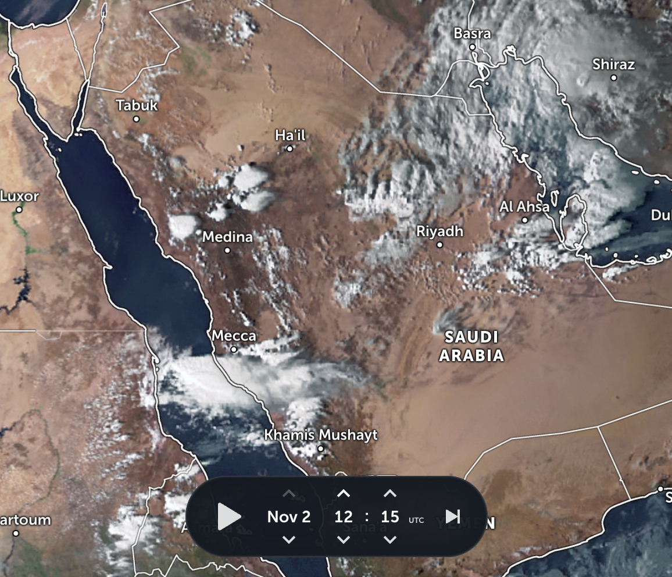
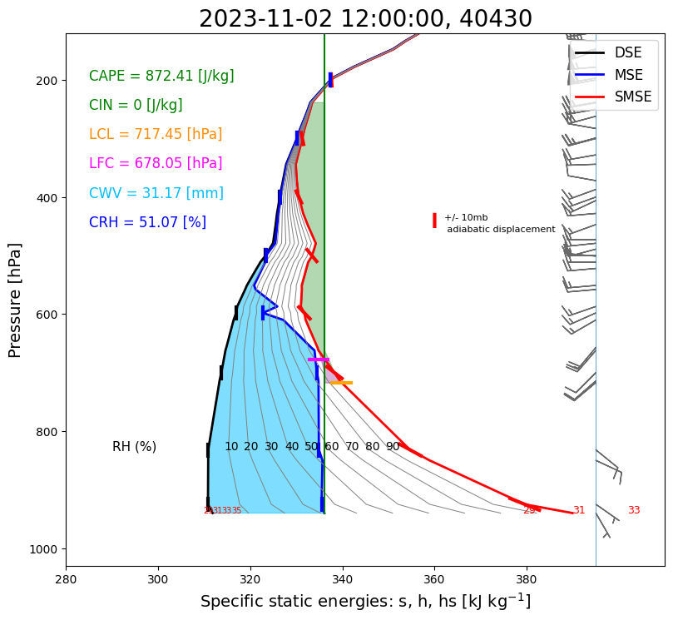

Slide 36
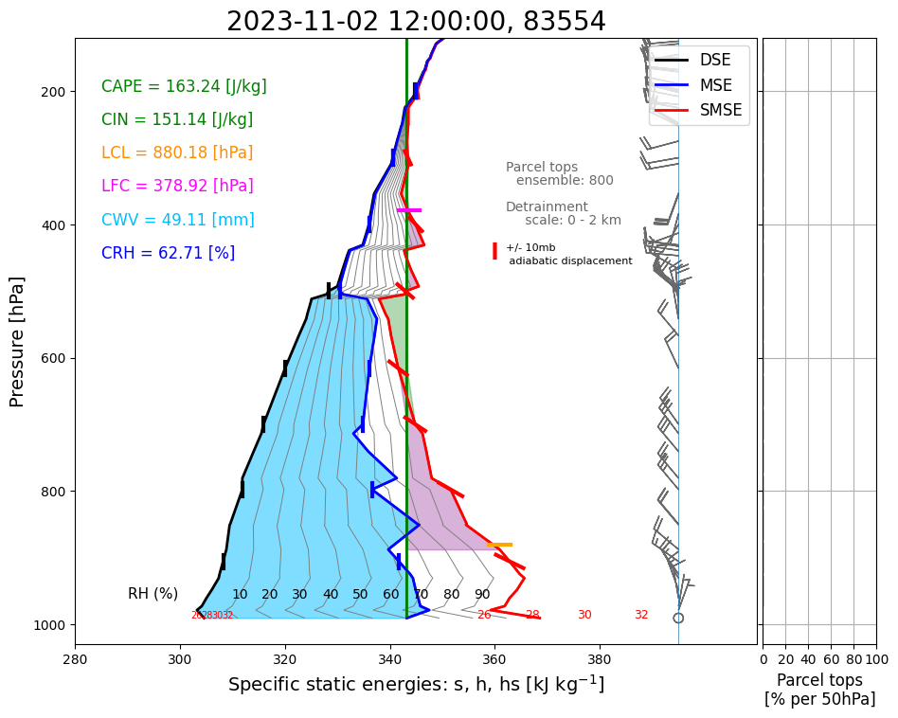
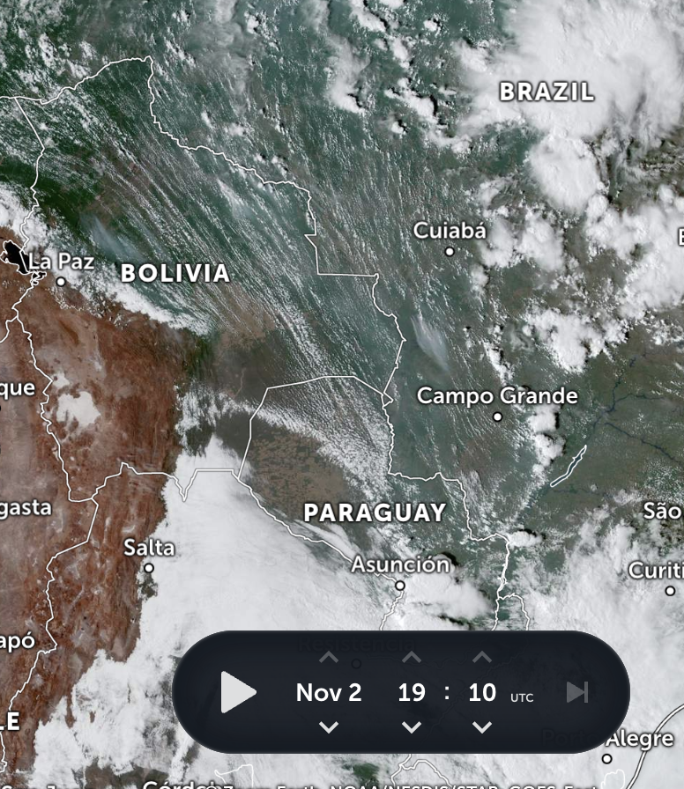

Slide 37
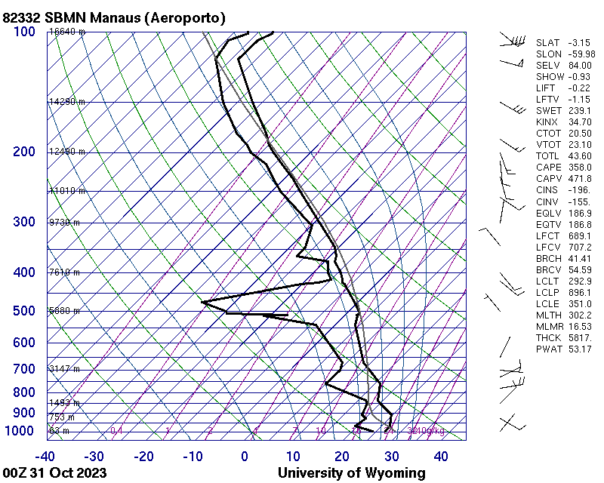
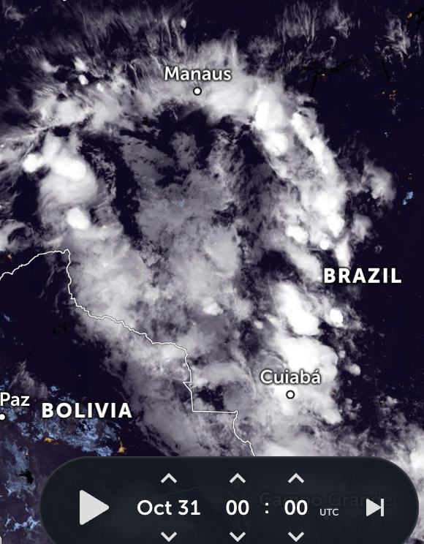
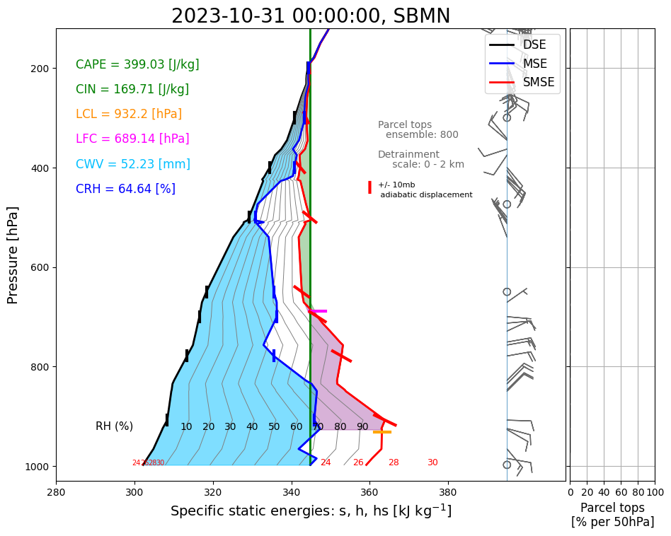

Slide 38
1. Good enough equations II
Thermodynamics
Air+water in thermodynamic eq'm: a 3-space
sensor: p, T, RH
dynamical: pressure, density, latent energy
conserved: pressure, entropy, water mass
clear: p, DSE = C_{p}T + gz_{hyd_ref}(p), MSE = DSE + Lq
Historical overhangs:
entropy since thermometers were invented first
A farewell to entropy, manifesto ch1 free on Web
T in energy units → entropy dimensionless like probability
aerological diagrams: mild nonlinearity w/o slide rule

Slide 39
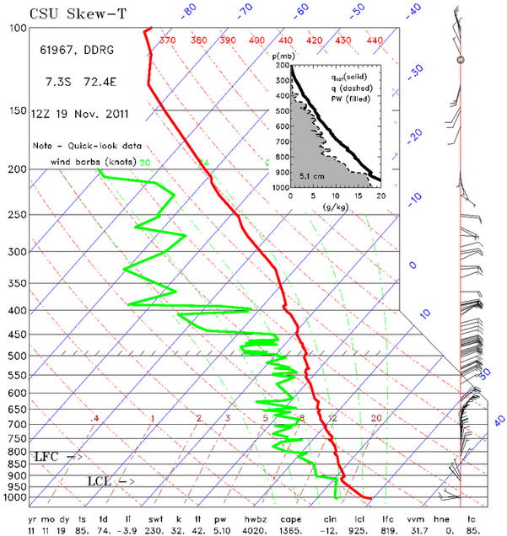
Traditional
skew-T:
T
Td
T

Slide 40
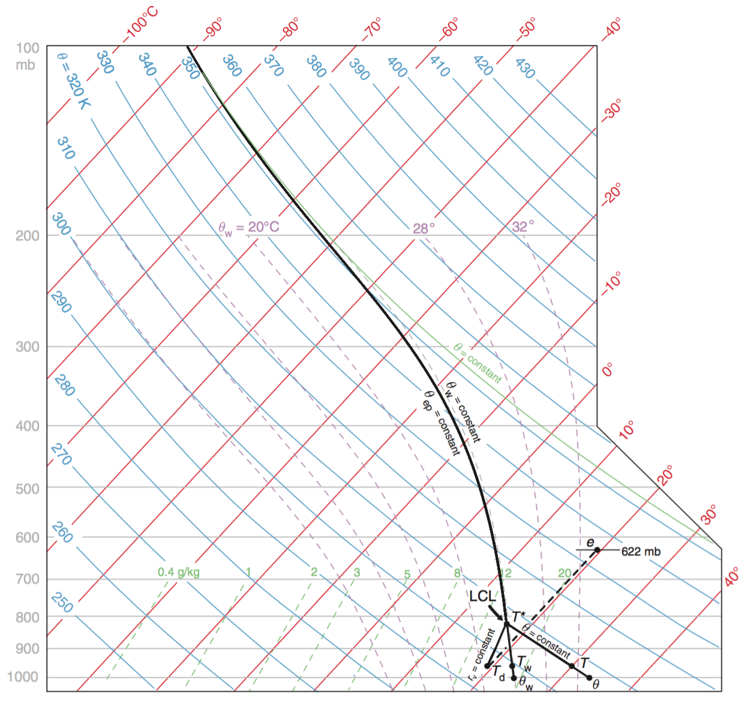
Why skew the T? Otherwise crazy wide

Slide 41
Why log-p? At least there’s a reason
Area on diagram is proportional to thickness Ζ’ = RT’/g Δln(p) for a layer of T’
Area on diagram is proportional to Work done by the buoyancy force on an undiluted parcel (CAPE) with a given T_{parcel}-T_{env}

Slide 42
Why T vs. log-p?
BUT
Not a view of mass (log-p rather than p; more like Z)
Crimped view of important lower troposphere
Very misleading, nonlinear, unhelpful view of moisture (as T-T_{d})
For instance, no graphical ability to see how dilution by a dry layer would affect buoyancy of lifted air parcels

Slide 43
Note the water vapor distortions and exaggerations of
skewT diagram!

